Slide 1
Multiple Sequence Alignment
Forrest Ireland, Mark Klick, John Talbot

Slide 2
Problem Statement
Multiple sequence alignment (MSA) is very important in bioinformatics.
Homologous sequences are compared to find biologically significant information.
We attempted to develop a de novo multiple sequence aligner loosely based on the Clustal algorithm using the Needleman Wunsch alignment algorithm.

Slide 3
Our Alignment Algorithm
Read in Sequences
Neighbor Joining
Pairwise Alignment (Needleman Wunsch)
Distance Matrix (Levenshtein Distance)
Join Nearest Nodes
Update Distance Matrix
Repeat until all the nodes have been joined

Slide 4
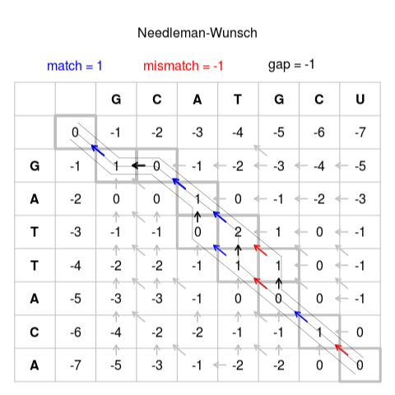
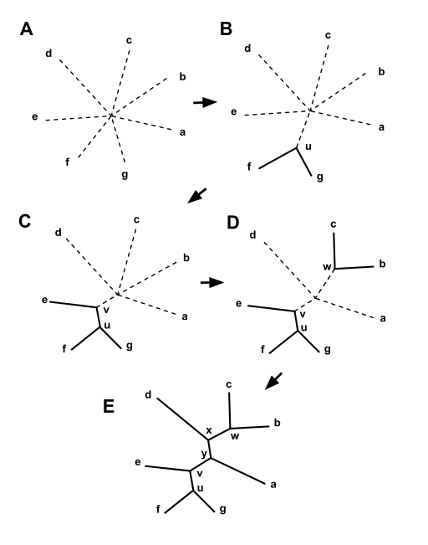

Slide 5
Theoretical Algorithm Analysis
N = number of sequences
M = average length of sequences
O((MN)²)

Slide 6
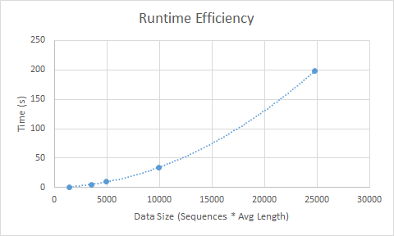
Empirical Runtime Results

Slide 7
Questions?

